Slide 1
SWFDP and SARFFG Workshop
24 October 2016
Vanetia Phakula

Slide 2
What is a flash flood
WMO: flood of short duration with a relatively high peak discharge.
AMS: a flood that rises and falls quite rapidly with little or no advance warning, usually as the result of intense rainfall over a relatively small area.
US NWS: a rapid and extreme flow of high water into geomorphic low-lying areas-rivers, dry lakes and basins, or a rapid water level rise in a stream or creek above a predetermined flood level.

Slide 3
Need for flash flood forecasting
According to WMO findings, flash floods were among the top most important hazards around the world.
On average, these events kill more people worldwide than any other natural disasters

Slide 4
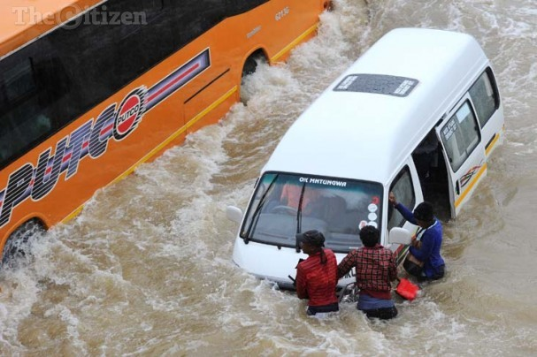
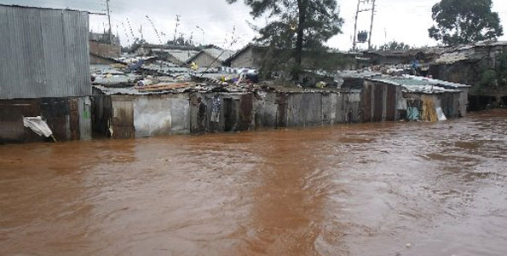
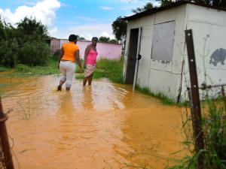
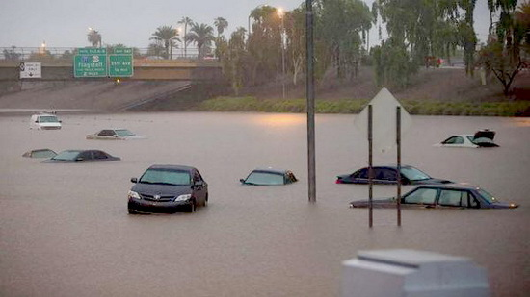

Slide 5
SARFFG

Slide 6
SAFFG
Interfaces

Slide 7
Radar
The radar rainfall estimates are provided on a grid having approximately 2x2 km resolution which is displayed over a background of SAFFG sub-basin boundaries.
The radar data products are updated every hour and reflect rainfall accumulations ending on the current navigation hour

Slide 8
Satellite
From geostationary satellites using the Hydro-estimator algorithm. The satellite rainfall estimates are provided on a grid having approximately 4x4 km resolution which is displayed over a background of SAFFG sub-basin boundaries.

Slide 9
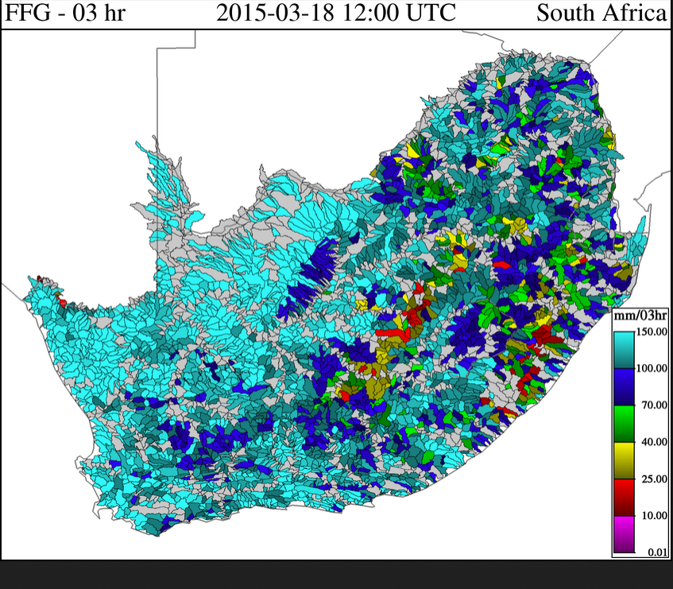
FFG & SARFFG (Flash Flood Guidance & South African Flash Flood Guidance System)

Slide 10
FFG
FFG value indicates:
The total volume of rainfall over the given duration which is just enough to cause bankfull flow at the outlet of the draining stream.
Consequently, rainfall volumes of the same duration that are greater than the FFG value indicate a likelihood of overbank flows at the draining stream outlet (covered in the base line threats)
10
Templ ref: PPT-ISO-colour.001 Doc Ref no: 24/10/2016

Slide 11
Baseline Threats

Slide 12
IFFT
IFFT - Imminent Flash Flood Threat
The values indicate the difference of the observed mean areal rainfall of the given duration and the corresponding past FFG of the same duration for a given SAFFG sub-basin.
The last 1-hour, 3-hour and 6-hour durations of FFG are considered with current corresponding Merged MAP in the computation of IFFT.
12
Templ ref: PPT-ISO-colour.001 Doc Ref no:24/10/2016

Slide 13
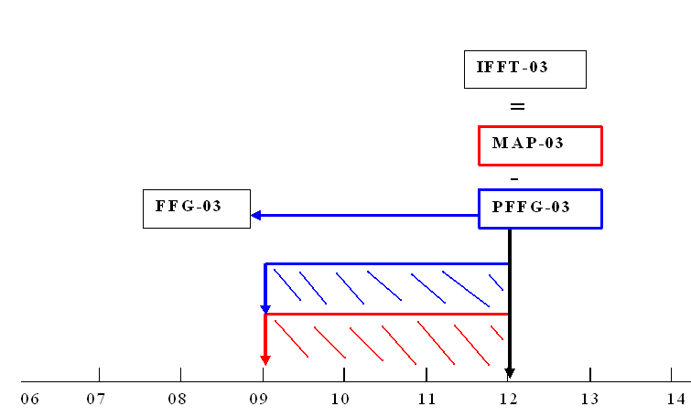
IFFTdt= MAPdt - PFFGdt
Templ ref: PPT-ISO-colour.001 Doc Ref no:24/10/2016

Slide 14
Note that this set of products concerns the past and may not be appropriate to use for real-time warning. In addition, significant uncertainty may be associated with the estimated mean areal precipitation. IFFT is offered as a baseline product that must be carefully evaluated by the forecaster in real-time.
14
Templ ref: PPT-ISO-colour.001 Doc Ref no:24/10/2016

Slide 15
PFFT
PFFT - Persistence Flash Flood Threat
Values indicate the difference of recent persisted merged estimates of mean areal rainfall of the given duration and the corresponding current FFG of the same duration for a given SAFFG sub-basin
15
Templ ref: PPT-ISO-colour.001 Doc Ref no:24/10/2016

Slide 16
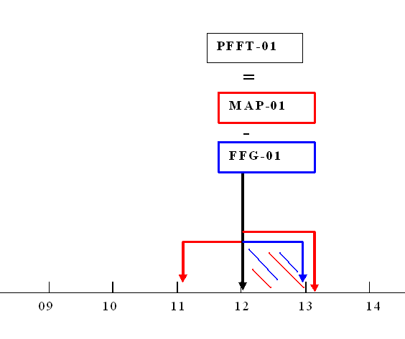
PFFT_{dt} = MAP_{dt}- FFG_{dt}
Templ ref: PPT-ISO-colour.001 Doc Ref no:24/10/2016

Slide 17
Hourly Rainfall Data for Gauteng 12 January 2016

Slide 18
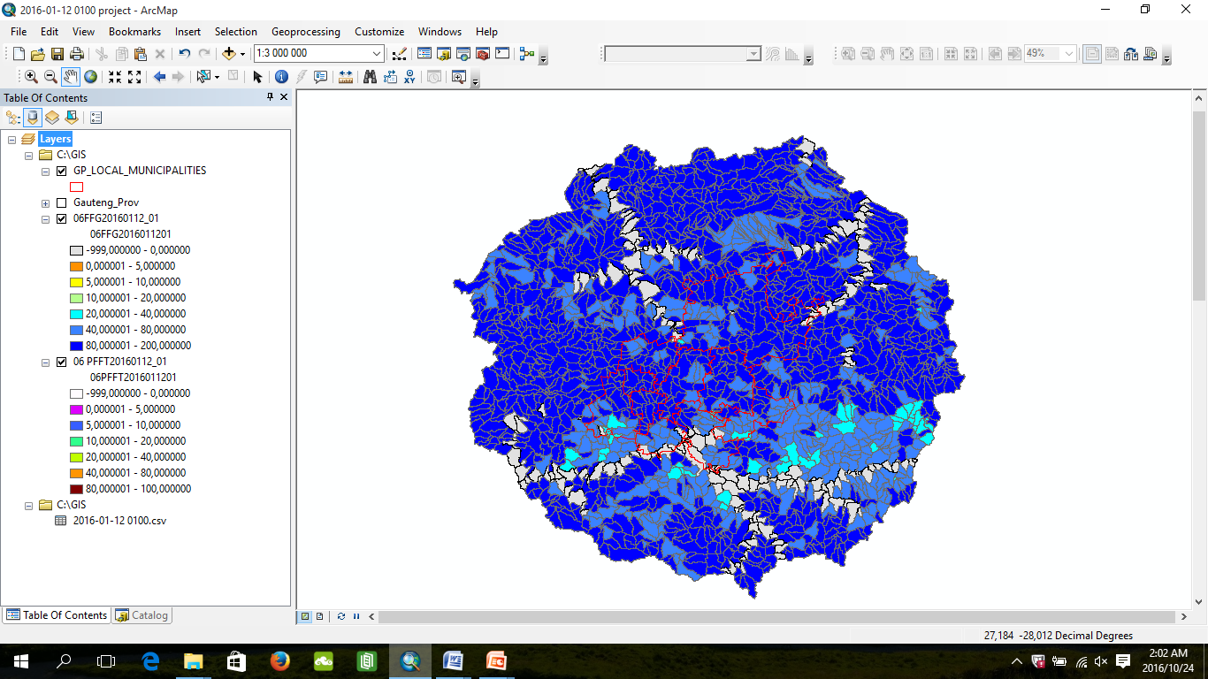
06 FFG 2016/01/12 01hr

Slide 19
06 FFG 2016/01/12 02hr

Slide 20
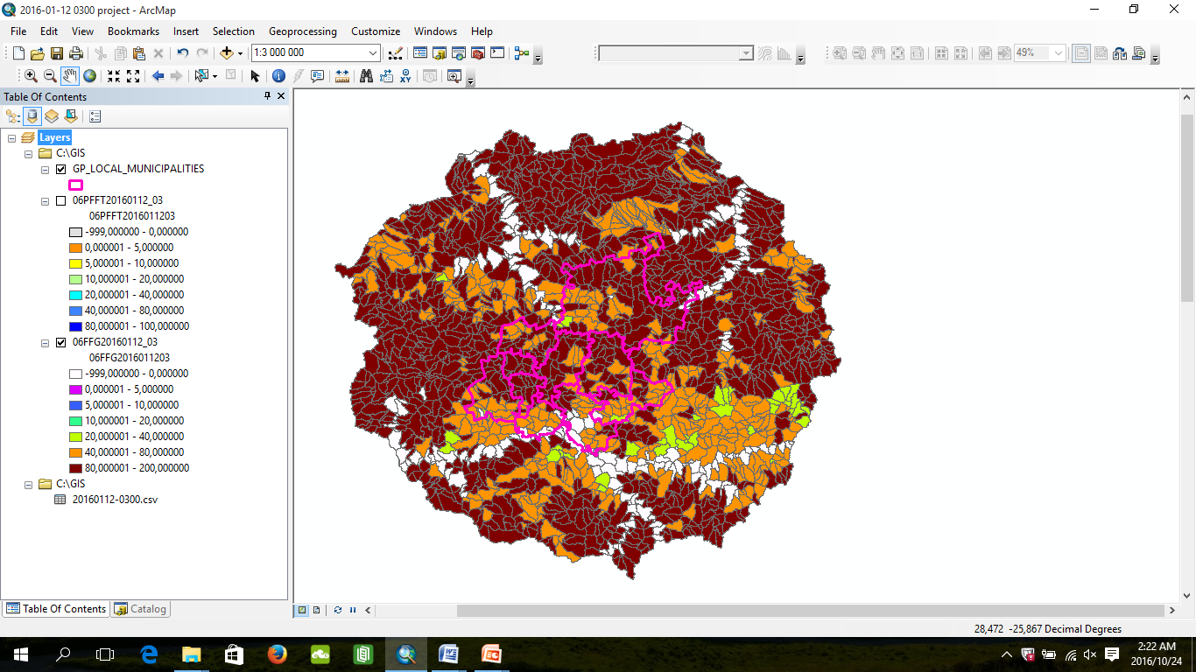
06 FFG 2016/01/12 03hr

Slide 21
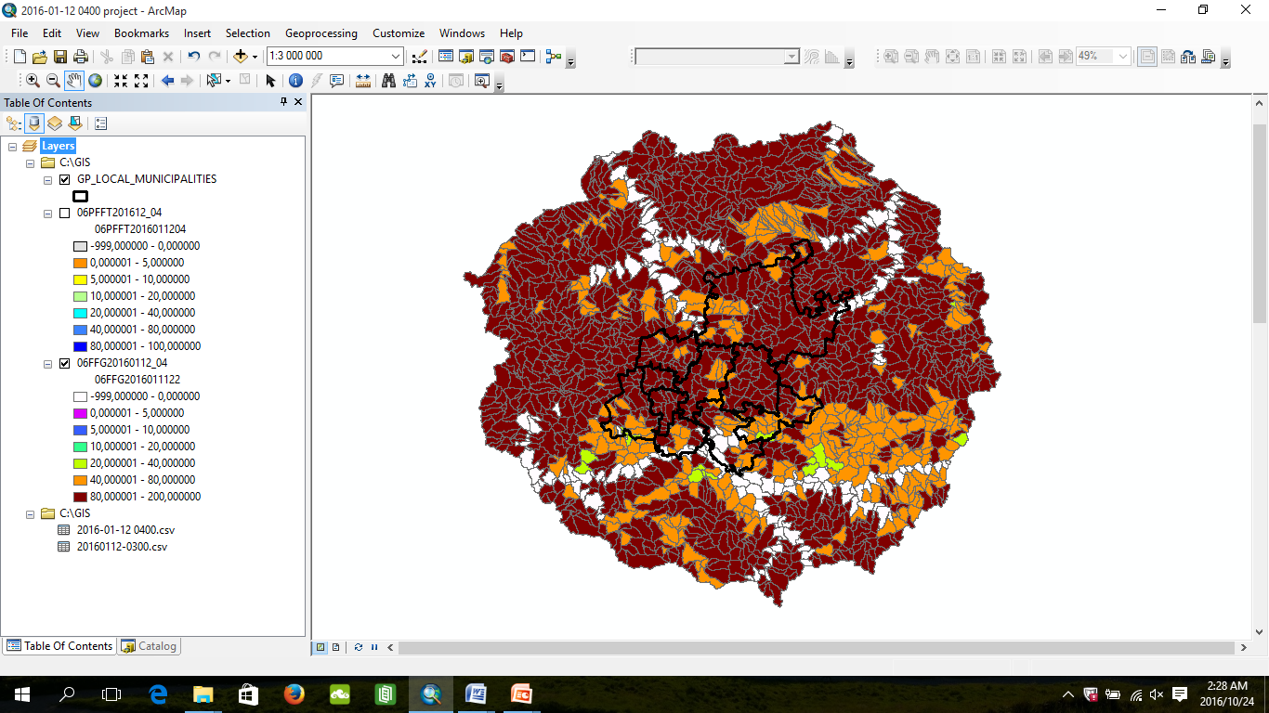
06 FFG 2016/01/12 04hr

Slide 22
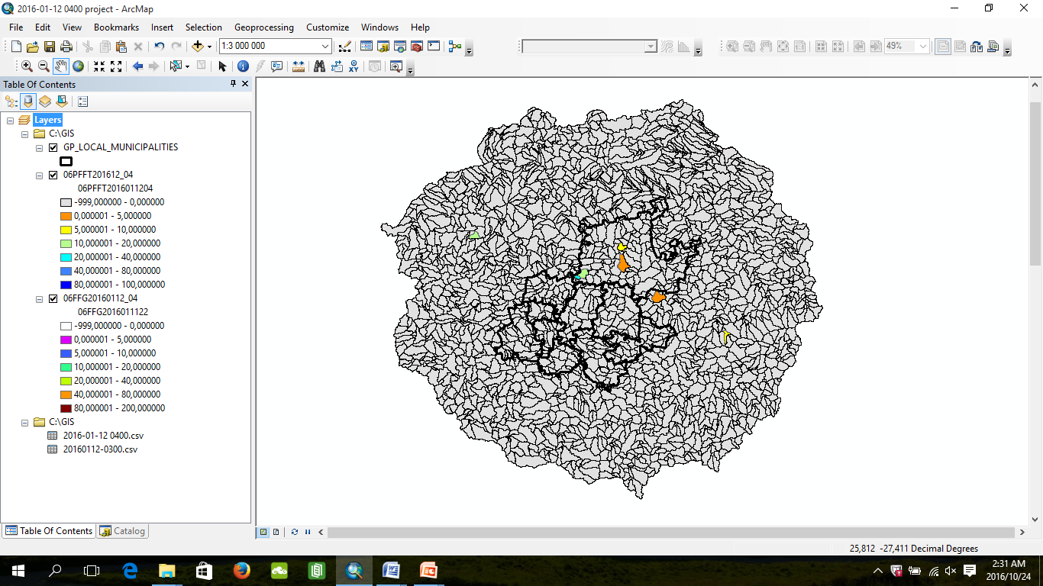
06 PFFT 2016/01/12 04hr

Slide 23
06 FFG 2016/01/12 05hr

Slide 24
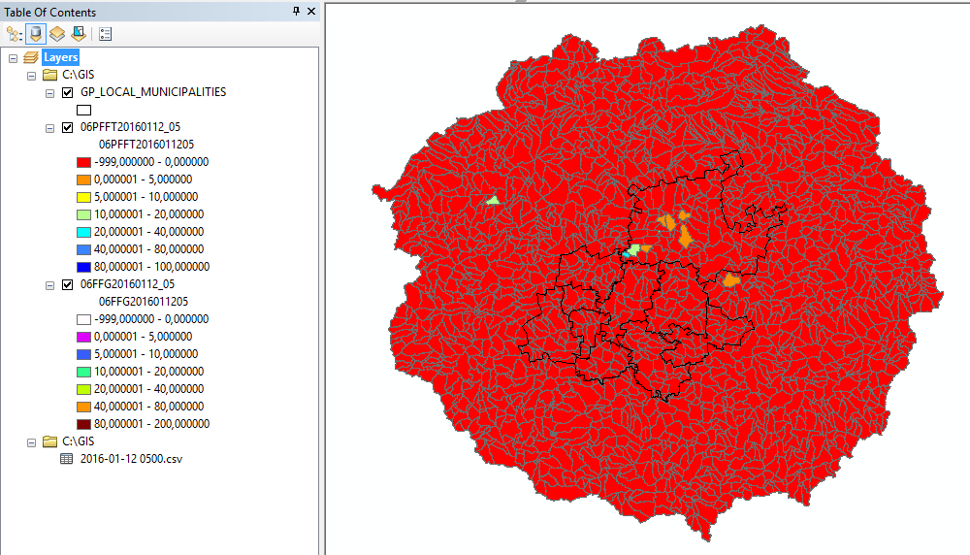
06 PFFT 2016/01/12 05hr

Slide 25
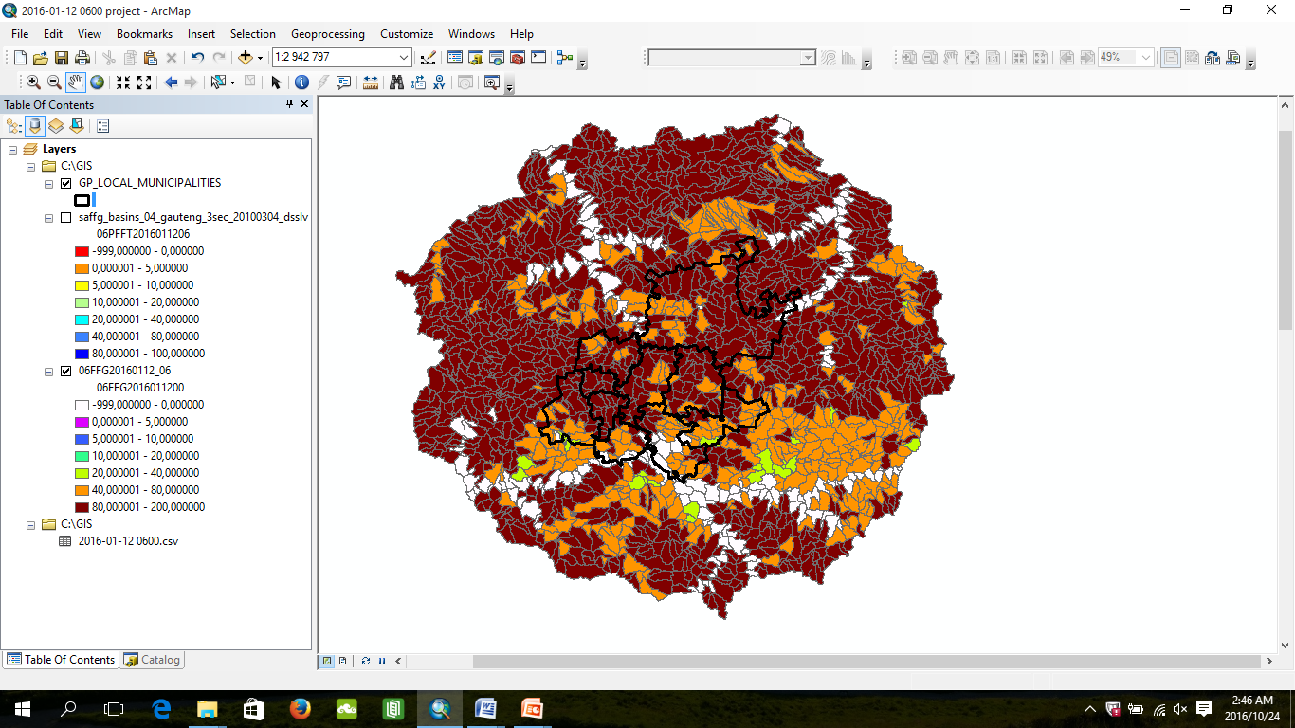
06 FFG 2016/01/12 06hr

Slide 26
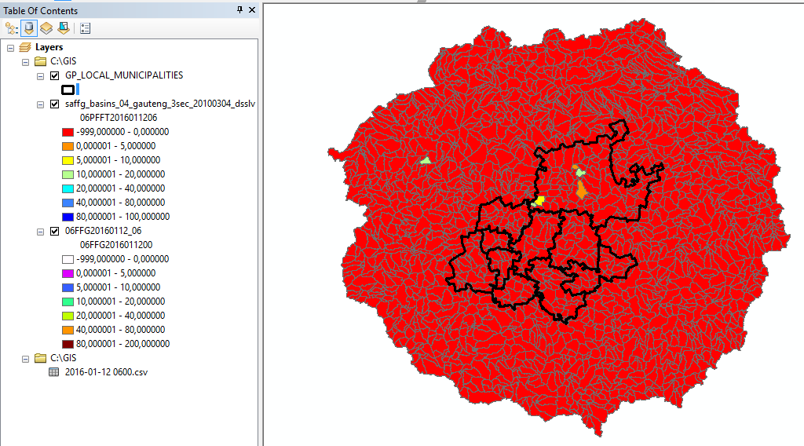
06 PFFT 2016/01/12 06hr

Slide 27
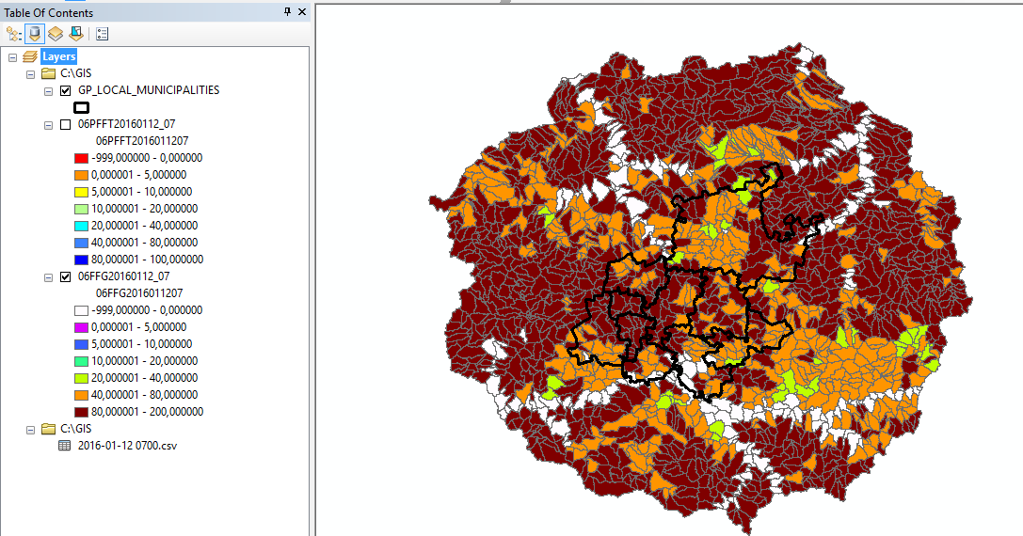
06 FFG 2016/01/12 07hr

Slide 28
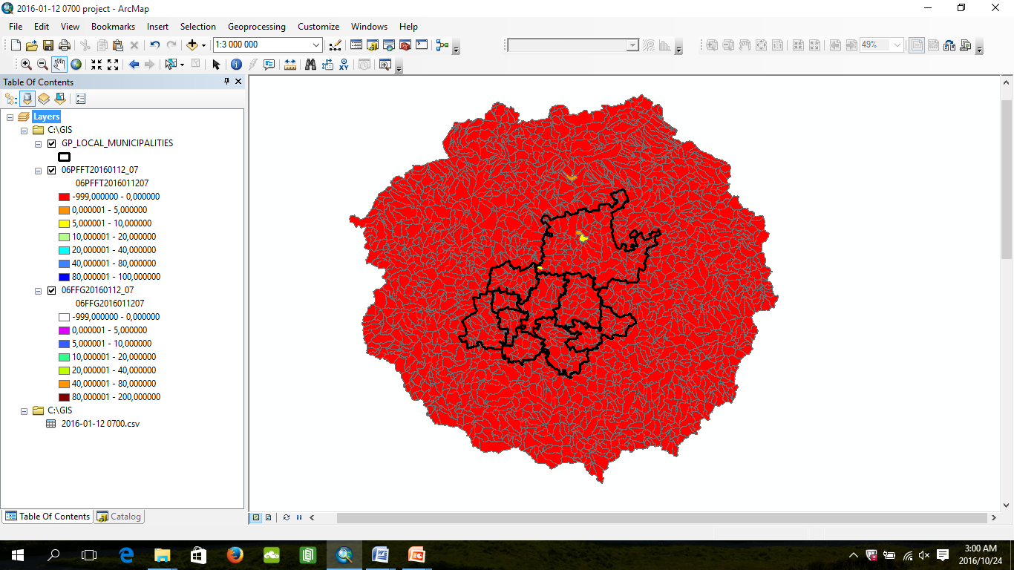
06 PFFT 2016/01/12 07hr

Slide 29
Data used for verification

Slide 30
Thank You

